Slide 1




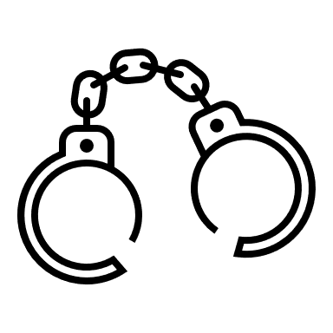




Notes:
What do you see?

Slide 2
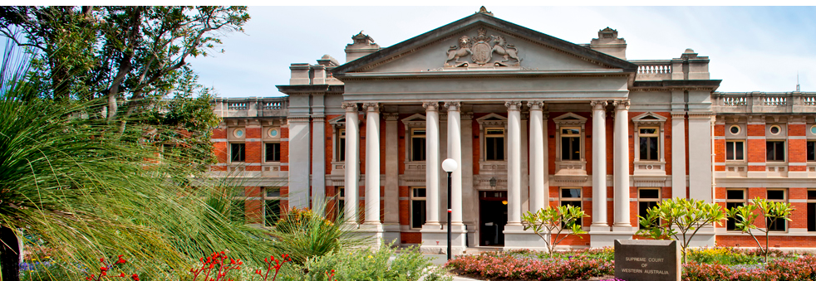
Criminal and Civil Law
Notes:
Supreme Court of Western Australia

Slide 3
Learning Intention
To investigate the difference between criminal and civil law.
Success Criteria
I can …
Describe the difference between criminal and civil law
Give examples of criminal and civil law
Describe common law torts
Give examples of one tort

Slide 4

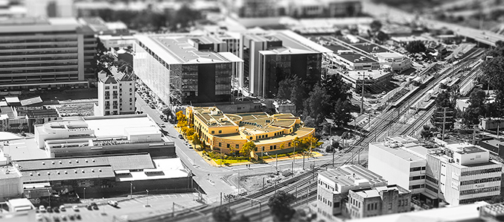
Introduction
Crimes such as murder, burglary and assault are all very serious crimes however, they are not the only type of offences for which people can go to court.
Court cases can involve either criminal or civil law and different courts hear different types of cases.
The Children's Court of Western Australia deals with offences alleged to have been committed by young people aged 10 to 17 years.

Slide 5
Hierarchy of West Australian Courts
Supreme
Court
District Courts
Magistrate Courts

Slide 6

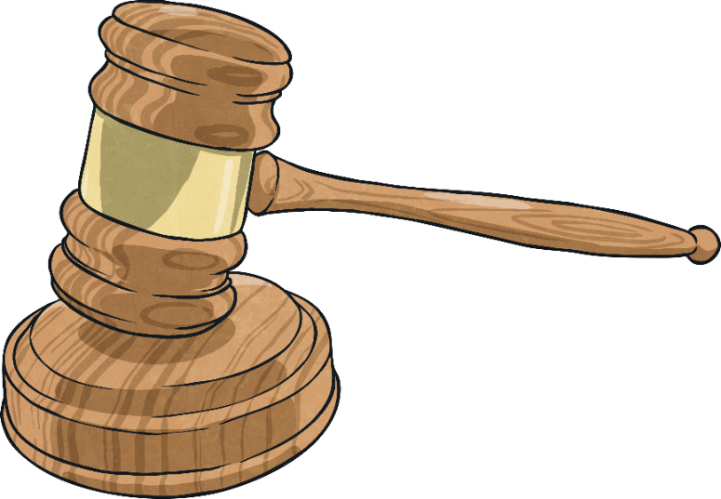
Criminal Law
Criminal law involves an offence that is seen as a threat to the whole community. Murder, arson and assault are all examples of criminal acts.
Criminal laws are a dispute between an accused person and the government. This means that the government takes responsibility for taking people accused of crimes to court and have them answer for what they have done.
Include some examples on your activity sheet

Slide 7
Criminal Law
The government takes the person to court on behalf of all the people in the community the four main types of criminal law are:
Get ready to write this list on your activity sheet
Laws that protect property
Laws that protect people
Laws that protect society
Laws that protect the nation and legal systems

Slide 8

Do you agree?
Should children be convicted for crimes in the same way as adults?
Should guardians be held responsible for the criminal actions of children?
Bail delay for boy on murder charge
Amanda Banks Legal Affairs Editor
Wed, 17 February 2016 7:25PM
An 11-year-old boy accused of murder had been charged with armed robbery and granted bail by police a week before he was allegedly involved in the fatal bashing, it was revealed in a Perth court today.
Emotional scenes erupted outside Perth Children’s Court after a bail application for the boy was adjourned, with family members of the man who died voicing a mix of anger and grief.
“We believe that if this child should be found guilty, he should be convicted to the full extent of the law for his actions as an adult.
“And that the responsibility for his actions should also fall back on to his legal guardians.”
Children that commit crimes are likely to grow out of the behaviour and become law abiding adults.
Children lack maturity and are more likely to take risks and are influenced by their peers.
Putting children in prisons with adults may reduce the chance of their rehabilitation as they could learn adult criminal behaviour.
Have you ever done something (not necessarily criminal) that you know that your parents/guardians would not approve of?

Slide 9
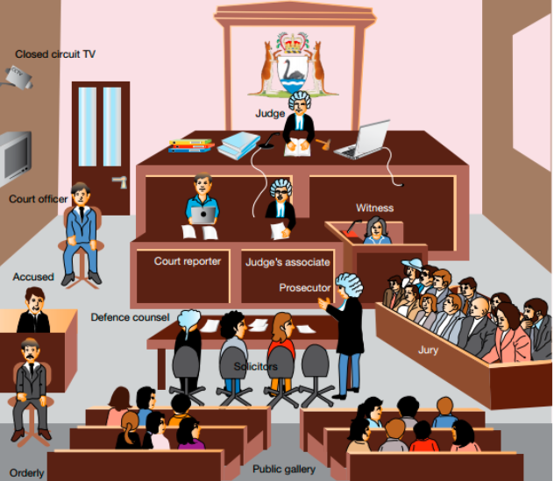
Closed Circuit TV
Judge
Court Officer
Witness
Court Reporter
Judge’s Associate
Accused
Defence Counsel
Prosecutor
Jury
Solicitors
Public Gallery
Orderly

Slide 10

Civil Law
Civil law involves disputes between individuals rather than the community as a whole.
Include some examples on your activity sheet
Examples of civil law include disputes between neighbours about barking dogs, or a loud party or a dispute between an individual and a shop about a purchased product.
If a case cannot be sorted out between
the people involved, it may need to go to
court

Slide 11
Civil Law
Civil law is often not an area that individuals worry about until it directly affects them, but it is important to know that there are many laws in place to offer protection.
Write this list on your activity sheet
There are three main types of civil law:
Contract Law
Family Law
Tort Law

Slide 12
Tort Law
Tort law is a particular kind of civil law and is derived through common law. They are wrongful acts that result in injury to another.
Include some examples on your activity sheet
Examples of torts are injury to another person’s body, property, dignity or reputation.
Torts can be classified as:
Trespass
Negligence
Nuisance
Defamation
Record this list on your activity sheet

Slide 13
Tort Law
How would you classify the noisy barking dog from the earlier slide?
Is it an example of:
Trespass
Negligence
Nuisance
Defamation

Slide 14
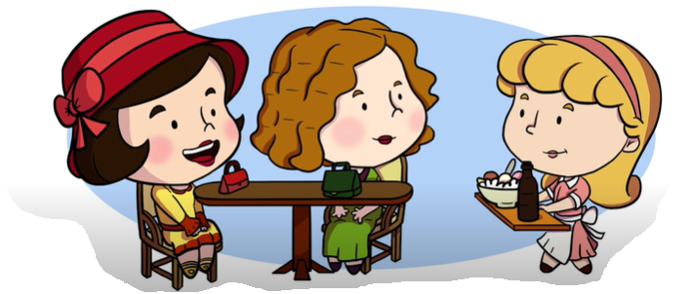

Donoghue v Stevenson a case of negligence
Write some notes on this case
on your activity sheet
Watch the video to see example of negligence and precedent in this famous case. Then complete Activity 2.
Notes:
https://www.youtube.com/watch?v=evDCHCMRAtc

Slide 15
Complete the Quiz
Check your understanding by completing the short quiz.

Slide 16
Success Criteria
I can …
Describe the difference between criminal and civil law
Give examples of criminal and civil law
Describe common law torts
Give examples of one tort

